Slide 1
ECE484W Final Project
By: Nicholas Barnes & Garland Johnson III

Slide 2
Introduction
In this project will are tasked to design a program that will allow you to pass camera data through the NIOS processor on the on-board monitor. Using your GUI and WiFi communication from previous labs, a user should be able to:
Transmit an image to the board and overlay that image to every frame of the video stream from the on-board camera.
Adjust brightness and contrast of the video stream from the on-board camera, via a program on the computer.
All changes are displayed on the board

Slide 3

Design Methodology
First we need to connect to the board. We defined a TCPSocket variable to send data to the board. Then we connected to the board using the connectToHost() function. We acquired the IP address from the board by looking our ISPs router settings and finding address linked to the name of the board.
Mainwindow.cpp

Slide 4
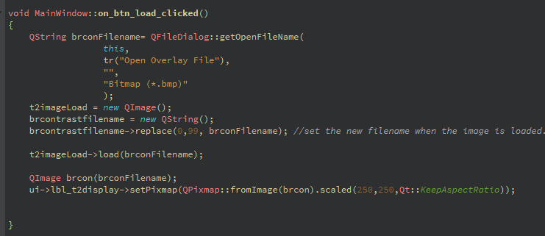
Design Methodology
In order to send an image to the board we have to load an image on our computer. We prompt the user to select a bitmap image to load and that image is stored in a QImage type variable and is stored for use across all slots.
Mainwindow.cpp

Slide 5
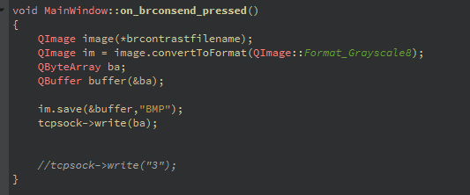
Design Methodology
Sending and overlaying the image that has been loaded is the difficult part. We have to prepare the board to be receive different kinds of data. We defined a qbytearray to load the image into, and we send that image over the network through a buffer.
Mainwindow.cpp

Slide 6
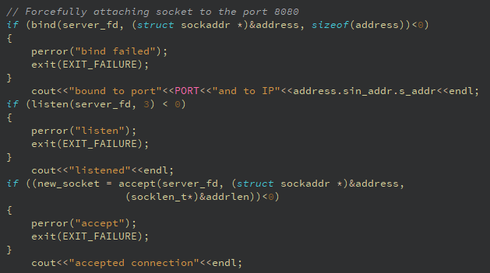
Design Methodology
The example on the board that opens the camera was edited to work like a TCP server It binds an ip and port number of the board to the server. Once the bind is complete, the server will start listening for data.
camera_in.cpp

Slide 7
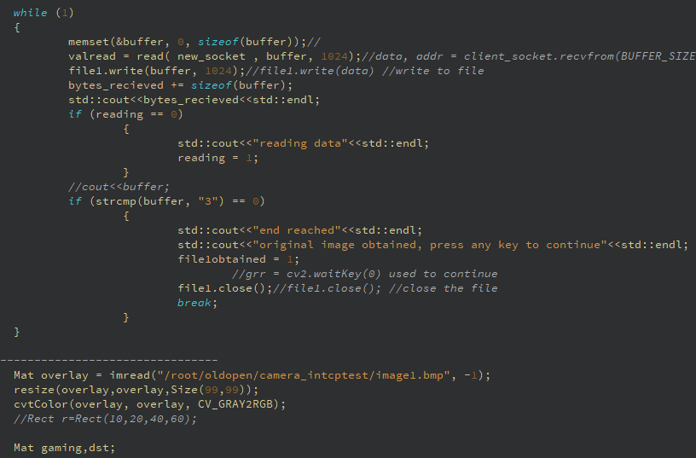
Design Methodology
We have two loops running, one for the images display from the camera and one to display the image transferred over the network. In the first loop,the server reads data sent from the client until an end code is transmitted. Once the data is obtained, it is written into an OpenCV image and resized to be overlayed in the next loop.
camera_in.cpp

Slide 8
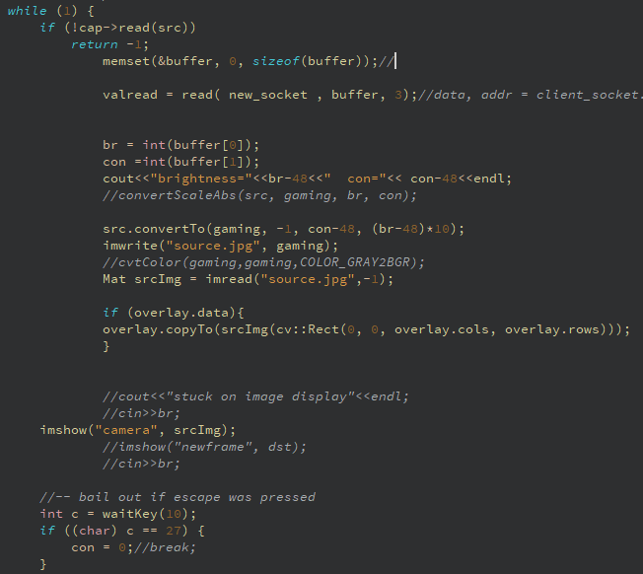
Design Methodology
The second loop displays the frame captured from the camera. Brightness and contrast values are sent from the client to the server and convertTo() adjusts the two values of the image. After adjustment, copyTo() is used to overlay the received image onto the camera frame.
camera_in.cpp

Slide 9
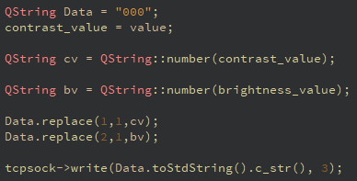
Design Methodology
The two sliders are used to determine the brightness and contrast. We defined a QString variable to store the values of the sliders. This data is sent to the board using the TCP protocol.
Mainwindow.cpp

Slide 10
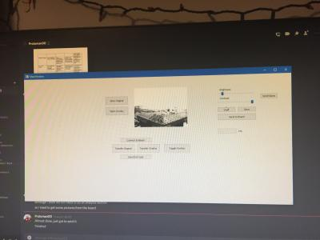
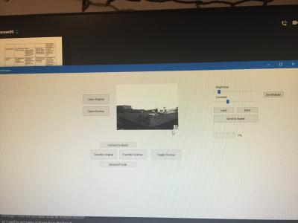
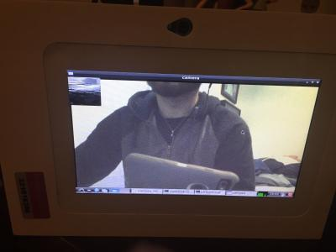
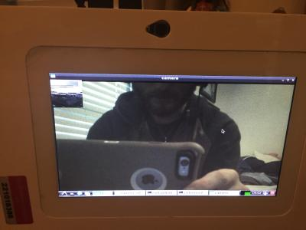
Analysis
High Contrast input
Normal Contrast input

Slide 11
Analysis
Sliders must be continuously adjusted in order for the camera frames to progress.
This is due to the loop waiting for a packet from the computer.
A timeout on the server end might fix the issue.
Sending values from the client continuously would solve the issue, but would need to figure out how to adjust the sliders during the loop.

Slide 12
Alternative Design
We had a working TCP server, overlaying, and brightness/contrast control algorithm in python from Assignment 4. However, we were unable to get input from the camera in the Python server. Thus, we resorted to C++.
If we figured out how to capture camera frames in python, we could have had more time to clean up the program, such as decreasing the time to send data to the board.

Slide 13
Conclusion
In the end we accomplished each requirement and developed a deeper understanding of network programming and image manipulation.

